Slide 1
How to Perform a Risk Assessment

Slide 2
Risk Assessment Steps
What is a risk assessment and why perform one?
What is my goal?
What could keep me from achieving my goal?
What are the possible outcomes?
What are my assumptions and are there correlations among drivers?
Is my response enough?
1
2
3
4
5

Slide 3
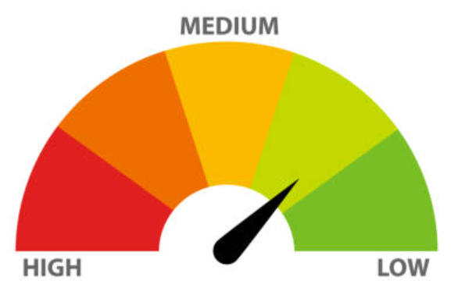
What is a risk assessment and why perform one?
Risk Assessment: The consideration of the extent to which potential events have an impact on the achievement of objectives. The assessment is done from two perspectives: impact and likelihood. It includes both positive and negative potential events.
Why perform risk assessments?
Minimize surprise and impact on operations and administration
Aid in quick, risk-informed, decision making including allocating time and resources
Allows risks to be prioritized and paired down for action
All risks map back to strategic goals and priorities

Slide 4
What is my goal?
1
Consider the short and long-term goals and objectives of your group at the University. These may be official statements or implied. What does it mean to be successful?
Its helpful to consider the University’s three-part mission and the MPact 2025 strategic plan. How does your group contribute to the achievement of the system-wide goals?

Slide 5
What could keep me from achieving my goal?
2
Falling short of a goal can result from many factors or events both internal and external to the University. These are your risks.
Remember, risk represents uncertainty so risk can be negative or positive. A risk event may occur that provides an opportunity.
A risk assessment should be done for each key risk or risk with the potential to have a significant impact on your goals. The Enterprise Risk Management group has created tools such as the Risk Self Assessment to help walk through the process.

Slide 6
What are the possible outcomes?
3
Best-Case
Worst-Case
Most-Likely
After identifying risks to the achievement of your goals or objectives, consider the possible outcomes and scenarios should those risks occur. Look for the worst-case, best-case, most-likely scenarios, and possibilities in-between. The Enterprise Risk Management group has created simple tools assess and score risks in a consistent way.

Slide 7
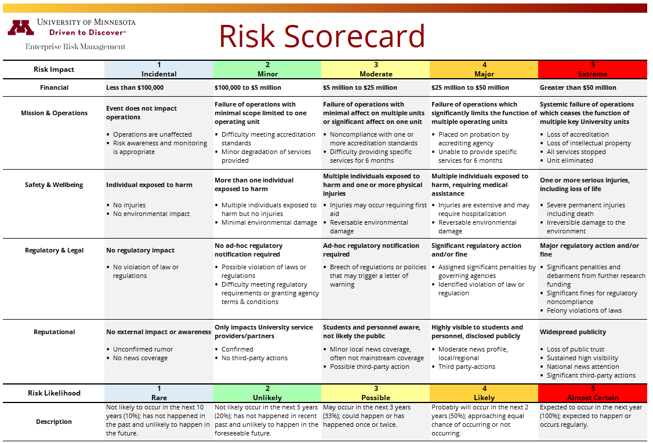
Tools & Resources
Consistent risk analysis tools are available at institution and local levels with tools like this scorecard.

Slide 8
What are my assumptions and are there correlations among drivers?
4
Examine your assumptions when considering risk scenarios. Leaders may rely too heavily on their experience creating “blind spots” in an unpredictable and sudden environment.
Consider relationships among risk drivers. Risk drivers are the causes or sources of risk such as market conditions, regulatory changes, or climate change. Risks are often interrelated affecting one another.

Slide 9
5
Is my response enough?
Leaders respond to risk in many ways. Approaches include:
Mitigation (controls): Controls generally include any action taken to reduce the impact or likelihood of a risk. Controls may include policies and procedures, preventative computer controls, management reviews, segregation of duties, training, and many others.
Transfer (or Sharing): Unacceptable risk can be transferred from the University to another party such as an insurance company, outside service provider, or market participant through hedging transactions.
Acceptance: There may be cases where a risk is acceptable without taking any action to reduce it.
Avoidance: Leaders may decide the risk cannot be reduced to an appropriate level and therefore avoid the underlying activity entirely.

Slide 10
Effectiveness of my response
Its helpful to consider the potential impact of risks both before and after any responses you’ve already taken. This helps define the “what could go wrongs.”
Inherent Risk: The risk to an entity in the absence of any actions the institution might take to alter either the risk’s likelihood or impact.
Residual Risk: The remaining risk after management has taken action to alter the risk’s likelihood or impact.

Slide 11
Mitigation Plan
If the risk assessment results in the need to further mitigate the risk, a risk mitigation plan is needed. The Enterprise Risk Management group has created tools to help identify the various components of your mitigation plan. A proactive and risk-aware response will increase the likelihood you achieve your goals!

Slide 12
Thank you!
Please feel free to reach out with additional questions.

